Slide 1

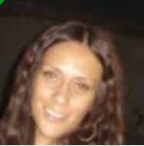


















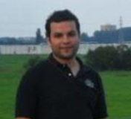
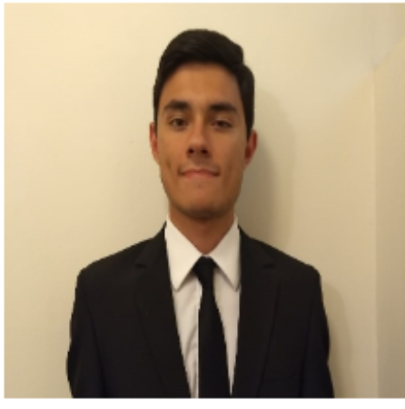










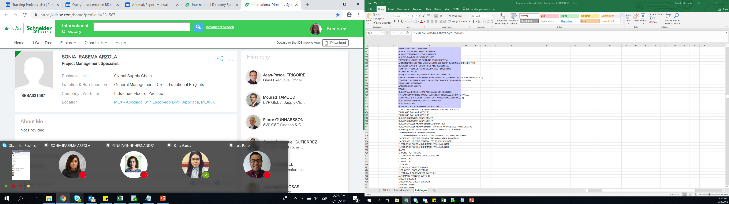
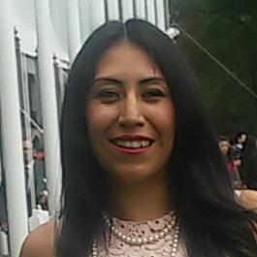
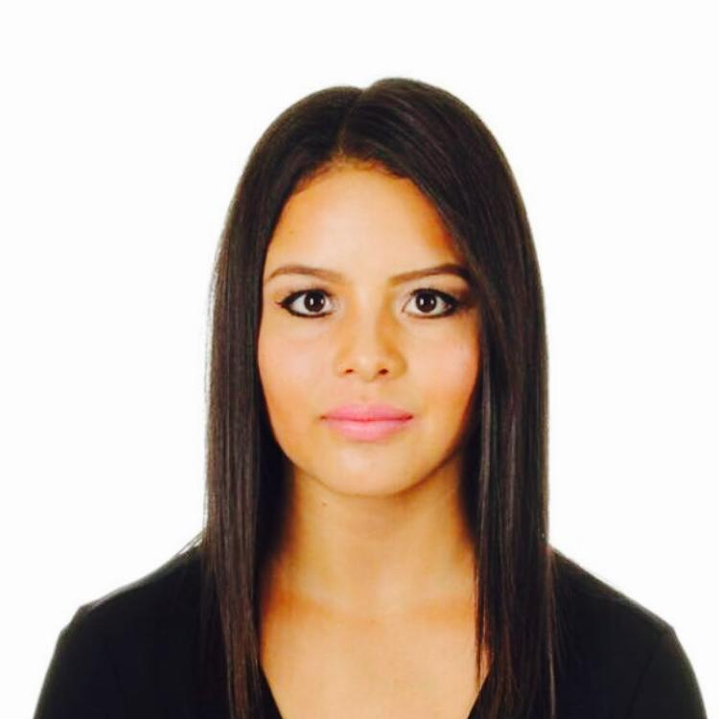


















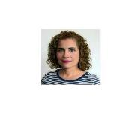








GSC NA Procurement – Transformation Organization
Horacio Galicia
Director Transformation,
MTY, MEX
Rosa Petrova
Business Process Manager,
El Paso, TX
Business Unit Partners
Strategic Projects & Program Management
Strategic Projects & Program Management
Juan Martin Rosas
Sr. Prj Mgr, MTY, MEX
Karthik Machiraju
Home & Distribution, Erlanger, KTz
Jan Heinrich UDE
Sr. Manager, MTY MEX
Leader PM
Diego Garza
Sr. Manager, MTY MEX
Leader PM
Tools & Processes Mgt. Resources Coordination
Lei Zackschewski
Power Products, Peru, IN
Fernando Rodriguez
Sr. Prj Mgr, TXA, MEX
Reb, CoS, QVE
Nilda Ramos
PM, MTY MEX
SBO P1
Osvaldo Balboa
PM, MTY MEX
QVE, CoS, SBO G´s
Madeleine Gutierrez
PM, MTY MEX
QVE, CoS, SBO K3
Julio Olivares
IT Analyst, MTY, MEX
IT Coordination / Web Apps
Luis Perez
IT Analyst, MTY, MEX
Web Apps Development
Veronica VIELMA Prj. Manager Intern,MTY,MEX PM support
Armando Romero
Prj Mgr, MTY, MEX
PMP certified
Alejandra Romero
Industry, Digital Energy & Secure Power, MTY, MEX
Karla Alonzo
Prj Mgr, El Paso, TX
PMP - CoS, QVE, SBO K3
Angel Nunez
PM, MTY MEX
SBO P1 D2-M2
Paola Gomez
Prj Mgr, TXA, MEX
QVE, Reb, Risk Mitigation, CoS
Juan Bacilio Garza
PM, MTY MEX
QVE, CoS, SBO D2-M2
Manuel Yanez
PM, MTY MEX
Diego Laureano
IT Intern, MTY, MEX
Web Apps Development
Brenda Mezquitic
IT Intern, MTY, MEX
Web Apps Development
Paola Rodriguez
IT Intern, MTY, MEX
Web Apps Development
Marlene Garza
Power Systems, MTY MX
PES & MOVE administrator.
Valdemar Berlanga
Prj Manager, MTY MEX
QVE, CoS, SBO K2
Mario Gutierrez
Prj Mgr, MTY, MEX
CoS, QVE
Ricardo Ruiz
PM, MTY MEX
QVE, CoS, SBO K1 and K2
Rosa Valdez Parks
PM, MO
SBO
Alexis Quezada
PM, MTY MEX
SBO K3
Idea Generation & Evolution
Carlos Galvan
Prj Mgr, MTY, MEX
CoS, QVE
Andres Chapa
PS, MTY, MEX
Idea Evolution (Digital Energy & PP)
Sonia Irasema Arzola
PS MTY, MEX
Alma Dulce Gomez
PS MTY, MEX
Idea Evolution (PP and Energy)
Salma Elisa Arteaga
PS, MTY, MEX
Procurement Project Specialist
Raul Raygoza
MTY, MEX
Idea Evolution (Power Systems and Home & Distribution)
Open Position
Manuel Solis
PIIT CoS Engr Mgr, MTY, MEX
Prj Mgr, CoS & SBO
Ricardo Gongora
Supplier Quality Manager
NAM Strategic Projects
Alondra Ibarra
PS, MTY, MEX
Project Specialist Intern
Stephany Carrillo
PS, MTY, MEX
Project Specialist Intern
Elena Manriquez
Elec-Mech Eng. PIITMTY, MEX
QVE & Reverse Engineering
Manuel Peinado
Elec-Mech Sr Eng.PIIT MTY, MEX CoS & SBO K5/K6
Jorge Chacon
Senior Designer, PIIT MTY MEX
Design 2D 3D/Rev Eng/QVE
Karen Puente
Designer, PIIT MTY MEX
Rev Eng / Design 2D 3D
Lucy Casas
Supplier Quality Engr MTY MEX NAM Strategic Projects
Armando Fernandez
Supplier Quality Engr MTY MEX
NAM Strategic Projects
Karla Juarez
Supplier Quality Engr MTY MEX
NAM Strategic Projects
Edgar Arredondo
Prod Design Eng. PIIT MTY, MEX
CoS & Core Team Member
Marco Rodriguez
Elec-Mech Engr, PIIT MTY, MEX
CoS & SBO
Karen Valeria VIDALES
Elec.Mech Engr, PIIT MTY MEX
Priscila Navarrete
Supplier Quality Engr MTY ME
NAM Strategic Projects
Raul de la Rosa
Supplier Quality Engr MTY MEX
NAM Strategic Projects
Aldo Cardenas
Supplier Quality Engr MTY MEX
NAM Strategic Projects
Hector Corpus
Mechanical Drafter, PIIT MTY MEX Design 2D 3D / Geomagic ctrl
Open Position
Fatima Guzman
Supplier Quality Engr MTY MEX
NAM Strategic Projects
Nayeli Diaz
Supplier Quality Engr MTY MEX
NAM Strategic Projects
Jose Luis Luna
Supplier Quality Engr TLX MEX
NAM Strategic Projects
Abraham de Leon
Mechanical Eng. PIIT MTY,MEX
CoS-Lessons Learned, SBO K1/K2
Gina Hernandez
Sr. Electronics Design Engr
CoS & QVE
Alan Salas Elec- Mech Engr, PIIT MTY MEX
Open Position
Karla Colin Renteria Supplier Quality Engineer
Open Position
Jose Lopez
Mechanical Drafter, PIIT MTY M Design 2D 3D / Geomagic Dx
Barbara Martinez
Elec-Mech Engr, PIIT MTY, MEX
CoS & SBO
Liza Martinez
Elec- Mech Engr, PIIT MTY MEX
QVE-COS
Open Position

Slide 2
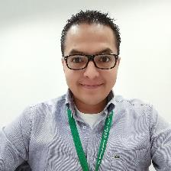

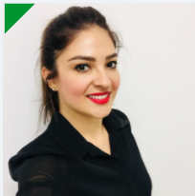

Business Unit Partners
Horacio Galicia
Director Transformation, MTY,MEX
Karthik Machiraju
Home & Distribution, Erlanger, KT
Alejandra Romero
Industry, Digital Energy & IT,
MTY,MEX
Lei Zackschewski
Power Products, Peru, IN
Marlene Garza
Power Systems, MTY MX
PSA and move administrator.
Notes:
This is an example of a Text Slide. Reference the different layout options in the Slide Master (under the View tab) for different variations. Remember, our new Brand Guidelines call for clean and simple messages and design. Reference the PowerPoint Guidelines on the Brand Book for tips and useful information on creating effective presentations.

Slide 3
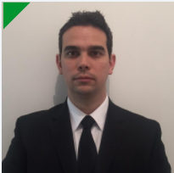
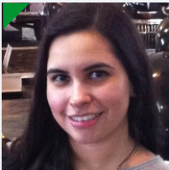


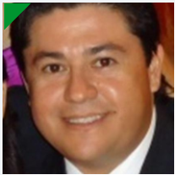



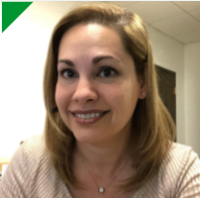
Strategic Projects & Program Management
Diego Garza
Sr. Manager, MTY MEX
Leader PM
Nilda Ramos
Prj Manager, MTY MEX
SBO P1
Ricardo Ruiz
Prj Manager, MTY MEX
QVE, CoS, SBO K1 and K2
Angel Nunez
Prj Mgr, MTY MEX
SBO P1 D2-M2
Juan Bacilio Garza
Prj Manager, MTY MEX
QVE, CoS, SBO D2-M2
Osvaldo Balboa
Prj Mgr, MTY MEX
QVE, CoS, SBO G´s
Alexis Quezada
Prj Mgr, MTY MEX
SBO K3
Madeleine Gutierrez
Prj Manager, MTY ME
QVE, CoS, SBO K3
Manuel Yanez
Prj Manager, MTY MX
Rosa Valdez Parks
Prj Mgr , MO
SBO
Notes:
This is an example of a Text Slide. Reference the different layout options in the Slide Master (under the View tab) for different variations. Remember, our new Brand Guidelines call for clean and simple messages and design. Reference the PowerPoint Guidelines on the Brand Book for tips and useful information on creating effective presentations.

Slide 4
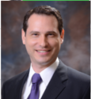

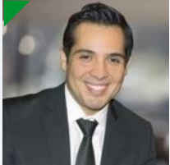

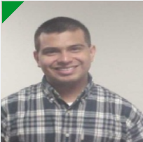

Strategic Projects & Program Management
Jan Heinrich UDE
Sr. Manager, MTY MEX Leader PM
Fernando Rodriguez
Sr. Prj Mgr, TXA, MEX
Reb, CoS, QVE
Armando Romero
Prj Mgr, MTY, MEX
PMP certified
Carlos Galvan
Prj Mgr, MTY, MEX
CoS, QVE
Paola Gomez
Prj Mgr, TXA, MEX
QVE, Reb, Risk Mitigation, CoS
Karla Alonzo
Prj Mgr, El Paso, TX
PMP - CoS, QVE, SBO K3
Mario Gutierrez
Prj Mgr, MTY, MEX
CoS, QVE
Valdemar Berlanga
Prj Manager, MTY MEX
QVE, CoS, SBO K2
Notes:
This is an example of a Text Slide. Reference the different layout options in the Slide Master (under the View tab) for different variations. Remember, our new Brand Guidelines call for clean and simple messages and design. Reference the PowerPoint Guidelines on the Brand Book for tips and useful information on creating effective presentations.

Slide 5
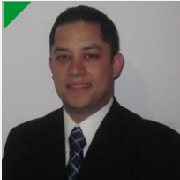
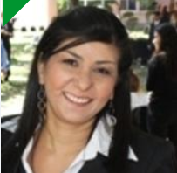

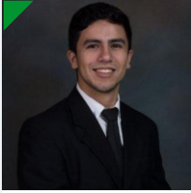
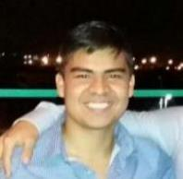




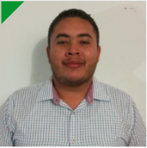
Project Engineers
Manuel Solis
PIIT CoS Engr Mgr, MTY, MEX
Prj Mgr, CoS & SBO
Elena Manriquez
Elec-Mech Eng. PIIT MTY, MEX
QVE & Reverse Engineering
Karen Puente
Designer, PIIT MTY MEX
Rev Eng / Design 2D 3D
Edgar Arredondo
Prod Design Eng. PIIT MTY, MEX
CoS & Core Team Member
Jorge Chacon
Senior Designer, PIIT MTY MEX
Design 2D 3D/Rev Eng/QVE
Abraham de Leon
Mechanical Eng. PIIT MTY,MEX CoS-Lessons Learned, SBO K1/K2
Karen Valeria Vidales
Elec.Mech Engr, PIIT MTY MEX
Manuel Peinado
Elec-Mech Sr Eng.PIIT MTY, MEX CoS & SBO K5/K6
Jose Lopez
Mechanical Drafter, PIIT MTY MEX
Design 2D 3D / Geomagic Dx
Gina Hernandez
Sr. Electronics Design Engr.
PIIT MTY, MEX, CoS & QVE
Liza Martinez
Elec- Mech Engr, PIIT MTY MEX
QVE-COS
Open Position
Barbara Martinez
Elec-Mech Engr, PIIT MTY, MEX
CoS & SBO
Open Position
Hector Corpus
Mechanical Drafter, PIIT MTY MEX
Design 2D 3D / Geomagic ctrl
Marco Rodriguez
Elec-Mech Engr, PIIT MTY, MEX
CoS & SBO
Alan Salas Elec- Mech Engr, PIIT MTY MEX
Open Position
Notes:
This is an example of a Text Slide. Reference the different layout options in the Slide Master (under the View tab) for different variations. Remember, our new Brand Guidelines call for clean and simple messages and design. Reference the PowerPoint Guidelines on the Brand Book for tips and useful information on creating effective presentations.

Slide 6

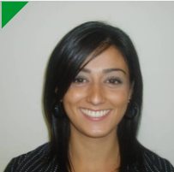

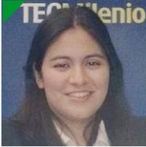




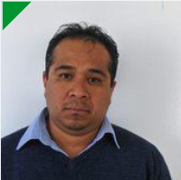
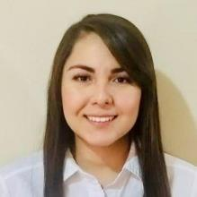
Supplier Quality & Logistics – Strategic Projects SQLD Team
Ricardo Gongora
Supplier Quality Manager
NAM Strategic Projects
Lucy Casas
Supplier Quality Engr MTY MEX NAM Strategic Projects
Armando Fernandez
Supplier Quality Engr MTY MEX NAM Strategic Projects
Karla Juarez
Supplier Quality Engr MTY MEX NAM Strategic Projects
Priscila Navarrete
Supplier Quality Engr MTY MEX NAM Strategic Projects
Raul de la Rosa
Supplier Quality Engr MTY MEX NAM Strategic Projects
Aldo Cardenas
Supplier Quality Engr MTY MEX NAM Strategic Projects
Fatima Guzman
Supplier Quality Engr MTY MEX NAM Strategic Projects
Nayeli Diaz
Supplier Quality Engr MTY MEX NAM Strategic Projects
Jose Luis Luna
Supplier Quality Engr TLX MEX NAM Strategic Projects
Karla Colin Renteria
Supplier Quality Engineer
Open Position
Notes:
This is an example of a Text Slide. Reference the different layout options in the Slide Master (under the View tab) for different variations. Remember, our new Brand Guidelines call for clean and simple messages and design. Reference the PowerPoint Guidelines on the Brand Book for tips and useful information on creating effective presentations.

Slide 7

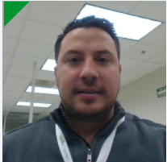

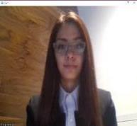
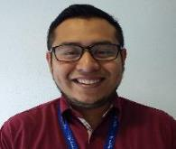

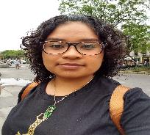
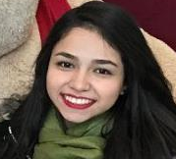
Tools Process Mgt, Resource Coordination & Idea Generation & Evolution
Juan Martin Rosas
Procurement Sr Program Mgr, MTY, MEX
Tools & Processes Mgt. Resources Coordination
Idea Generation & Evolution
Andres Chapa
Prj Specialist MTY, MEX
Idea Evolution (Digital Energy & PP)
Alma Dulce Gomez
Prj Specialist MTY, MEX Idea Evolution (PP and Power Systems)
Alondra Ibarra
PS MTY, MEX
Project Specialist Intern
Julio Olivares
IT Business Partner, MTY, MEX
IT Coordination / Web Apps Dev
Brenda Mezquitic
IT Intern, MTY, MEX
Web Apps Development
Salma Elisa Arteaga
Prj Specialist MTY, MEX
Idea Evolution (Home & Distribution, PP)
Sonia Irasema Arzola
Prj Specialist MTY, MEX
Idea Evolution (Industry & Digital Energy)
Luis Perez
IT Analyst, MTY, MEX Web Apps Development
Diego Laureano
IT Intern, MTY, MEX
Web Apps Development
Stephany Carrillo
PS MTY, MEX
Project Specialist Intern
Raul Raygoza
Prj Specialist MTY, MEX
Idea Evolution (Power Systems, Home & Distriution)
Veronica Vielma
Project Manager Intern, MTY, MEX PM support
Paola Rodriguez
IT Intern, MTY, MEX
Web Apps Development

